Slide 1
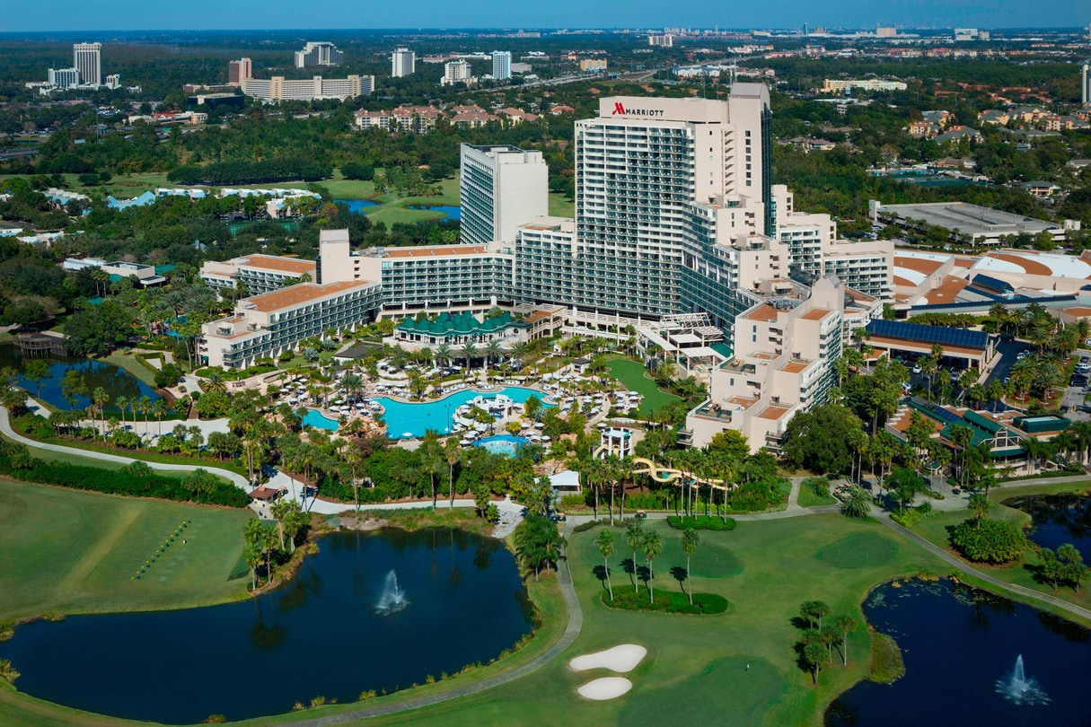

COMING TO ORLANDO IN 2023

Slide 2
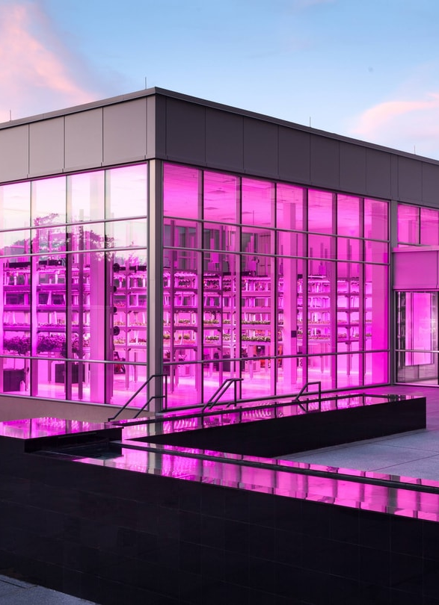
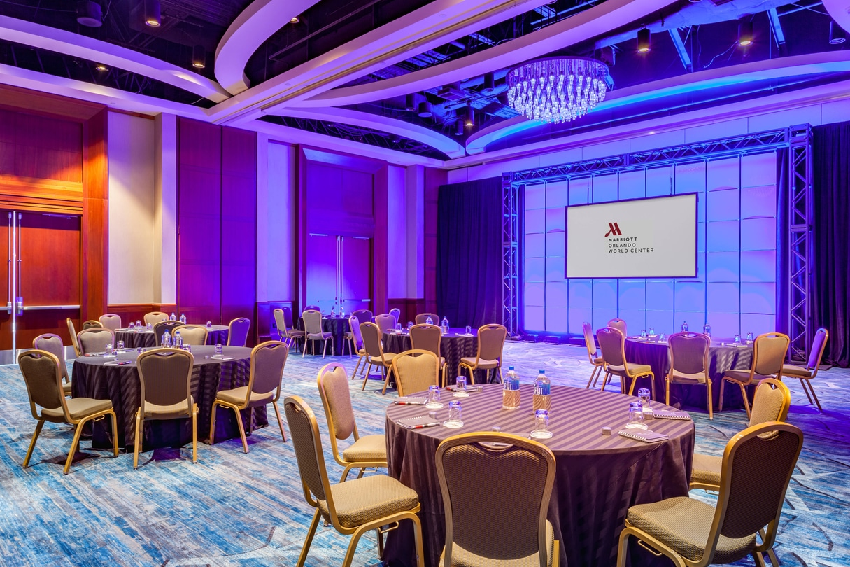
ELEVEN CONFERENCES

Slide 3

SEVEN DAYS

Slide 4
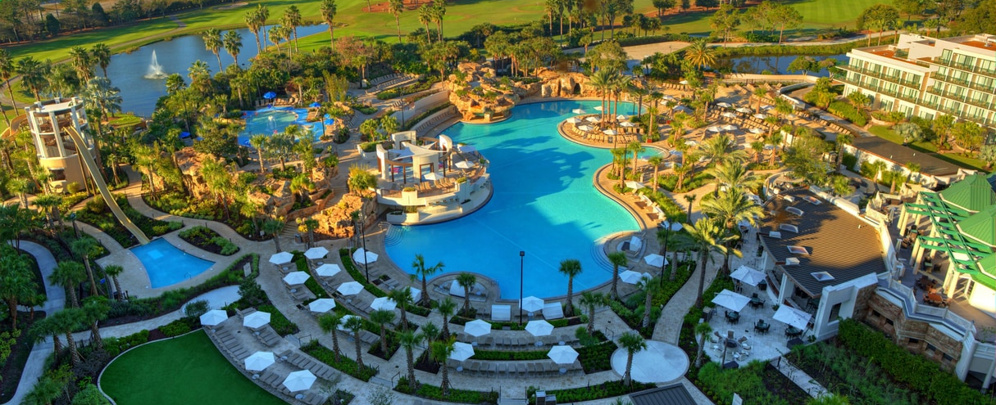

ONE PLACE
ORLANDO WORLD CENTER MARRIOTT

Slide 5

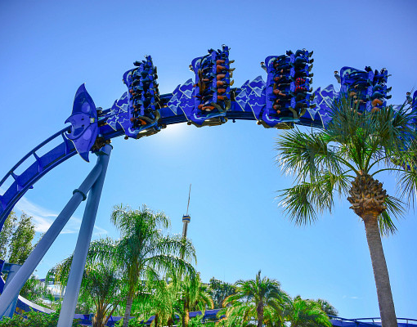

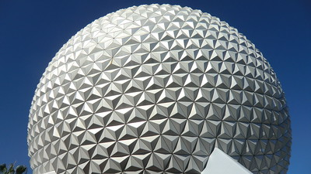
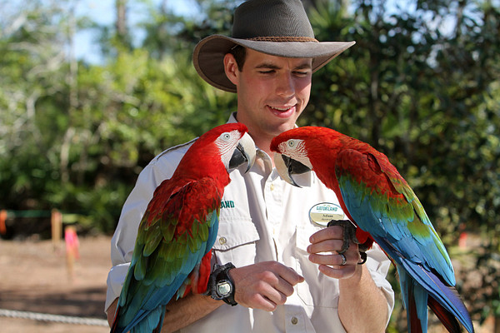
ORLANDO FLORIDA

Slide 6
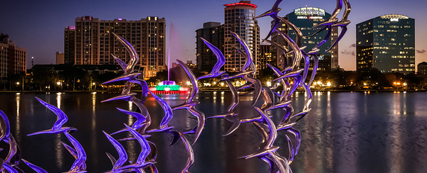
ACM FCRC 2023
Federated Computing Research Conference
June 16-23, 2023 – Orlando World Center Marriott
Orlando, Florida

Slide 7
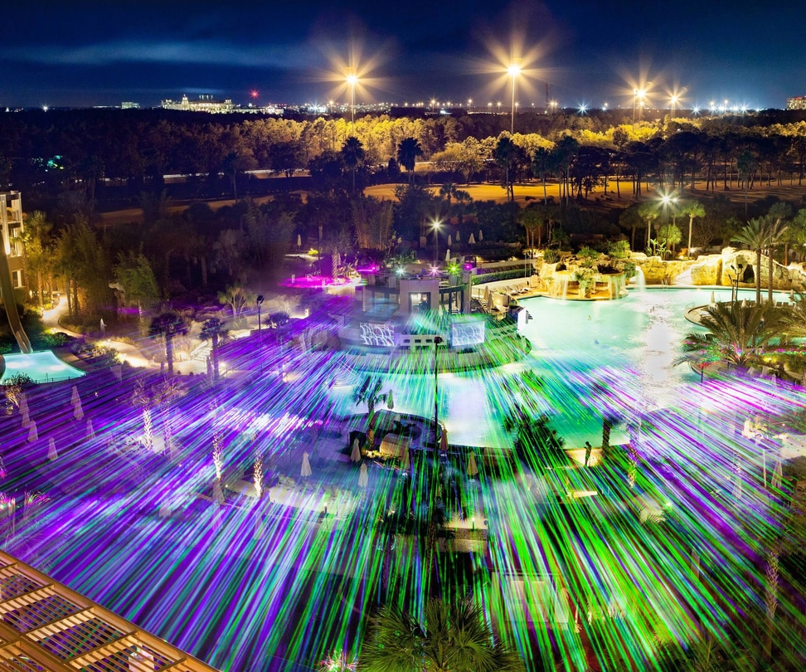
PARTICIPATING CONFERENCES
HPDC’23
PLDI’23
CHASE’23
SPAA’23
PADS’23
ISCA’23
PODC’23
IWQoS’23
METRICS’23
e-ENERGY’23
STOC’23

Slide 8
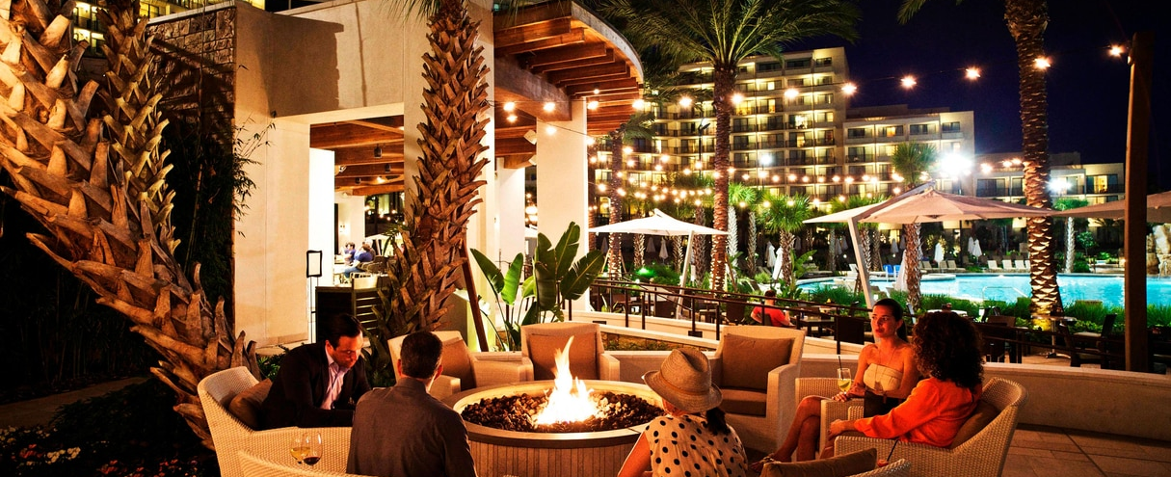

JOIN US FCRC.ACM.ORG

